Slide 1
PROJECT TITLE
CAPSTONE PROJECT
Presented By: Shaik Allabakash
Student Name : Shaik Allabakash
College Name : Shri Gnanambica degree college
Department : BCA

Slide 2
OUTLINE
Problem Statement
Technology used
Wow factor
End users
Result
Conclusion
Git-hub Link
Future scope

Slide 3
Problem Statement
Develop a Python-based Image Steganography application with a Command-Line Interface (CLI) to securely hide and retrieve text messages within images.
The program should allow users to select an image, encrypt a secret message using pixel manipulation, and save the modified image.
It should also enable decryption by extracting the hidden message upon entering the correct passcode.
The system must ensure data integrity, non-interactive execution, and secure access to hidden messages.

Slide 4
Technology used
Programming Language:
Python (OpenCV for image processing, NumPy for data handling)
Libraries & APIs:
OpenCV (cv2) – For reading, modifying, and saving images
NumPy – For handling pixel data efficiently
Sys – For command-line execution
OS – For file handling and path management
Platform Compatibility:
Operating System: Windows, macOS, Linux
Python Version: Python 3.6 or later
Development Environment:
IDE: PyCharm, VS Code, Jupyter Notebook
Build Tool: No specific build tool required (can use virtual environments for dependencies)
This setup ensures a cross-platform, lightweight, and user-friendly application for image steganography.

Slide 5
Wow factors
1.Passcode-Protected Encryption – Ensures that only authorized users with the correct passcode can retrieve the hidden message, adding an extra layer of security.
2.Custom End Marker (@@@) – Prevents unnecessary extraction of random noise, ensuring precise message retrieval without corruption.
3.Lossless Message Encoding – Utilizes Least Significant Bit (LSB) manipulation, preserving the original image quality while embedding the secret message.
4.Universal Compatibility – Works across Windows, macOS, and Linux, requiring minimal dependencies (OpenCV & NumPy) for seamless execution.
5.User-Friendly & Lightweight – No need for external databases or complex setups, making it ideal for quick and efficient steganography tasks.
6.Automated Detection of Image Issues – The program checks if an image can be opened before processing, preventing crashes due to incorrect file types.

Slide 6
End users
1.Cybersecurity Enthusiasts & Researchers – Use steganography for secure data transmission and encryption research.
2.Journalists & Whistleblowers – Hide sensitive information within images to communicate securely without detection.
3.Law Enforcement & Intelligence Agencies – Securely embed and retrieve confidential messages for covert operations.
4.Privacy-Conscious Individuals – Protect personal data by embedding secret messages within everyday images.
5.Software Developers & Security Analysts – Implement and analyze steganographic techniques in real-world applications.
6.Forensic Experts – Detect and analyze hidden data within images for cybersecurity investigations.

Slide 7
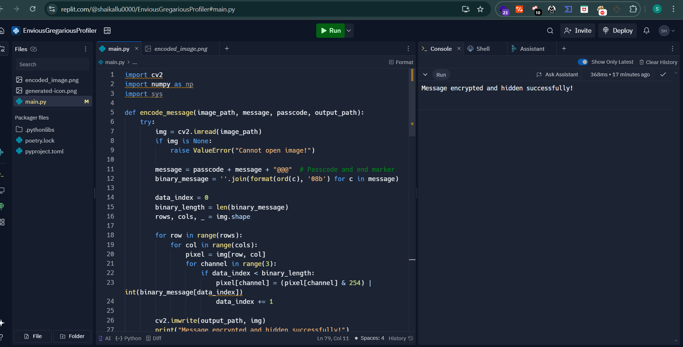
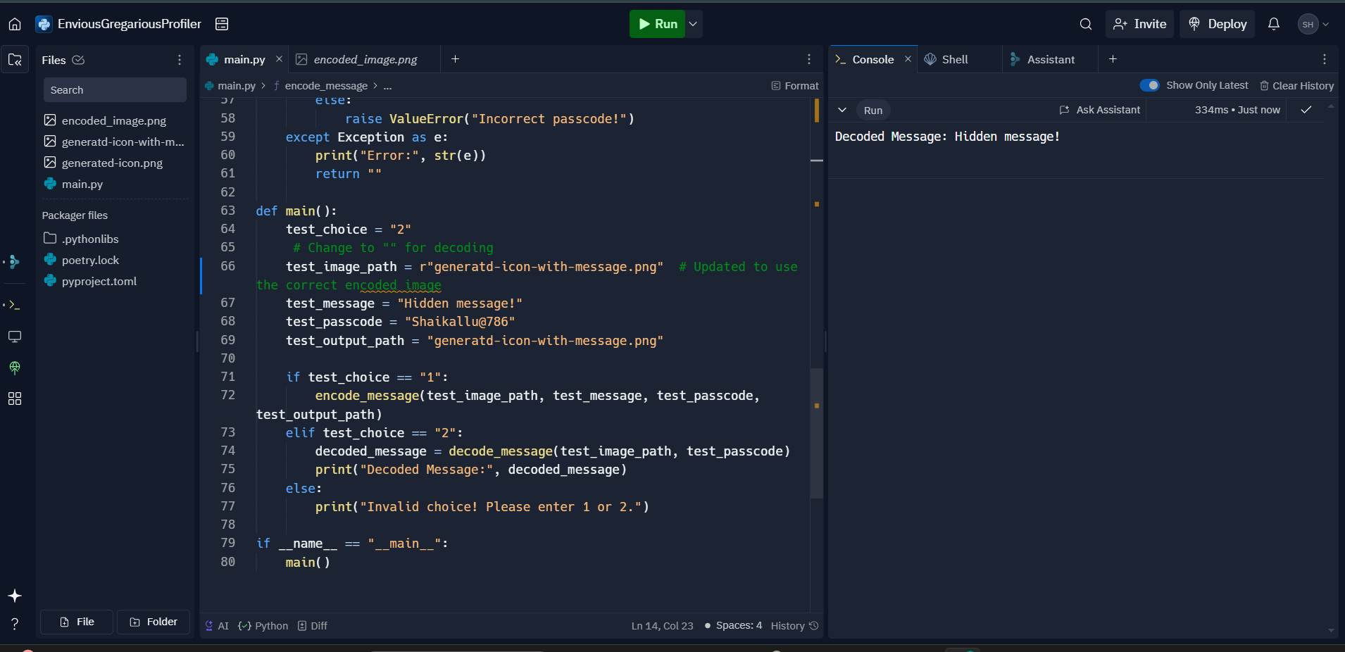
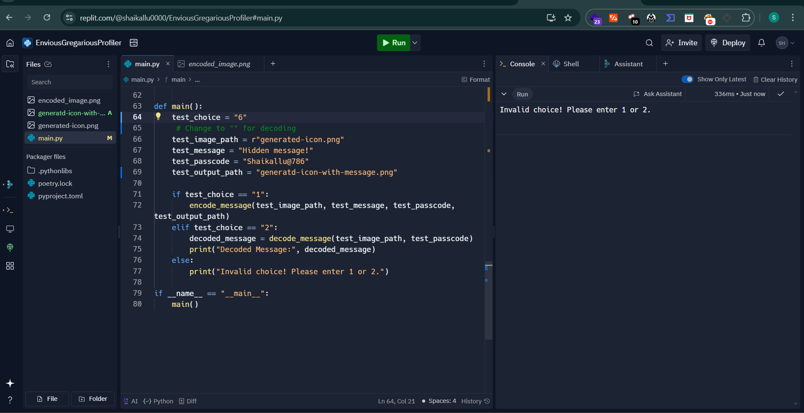
Results

Slide 8
Conclusion
This Image Steganography project successfully implements a secure and efficient method for hiding and retrieving text messages within images using Python and OpenCV. By embedding the message at the pixel level and securing it with a passcode, the project ensures data confidentiality and integrity.
The decoding process verifies the correct passcode before revealing the hidden message, adding an extra layer of security. The project can be further enhanced with stronger encryption methods, improved UI, and support for multiple image formats.
Overall, this project serves as a practical solution for secure communication and can be applied in data security, watermarking, and covert messaging applications.

Slide 9
GitHub Link
Make sure that there should be readme file

Slide 10
Future scope(optional)
1.Stronger Encryption
Implement AES or RSA encryption to further protect hidden messages.
Use hashing techniques to verify message integrity.
2.Graphical User Interface (GUI)
Develop a user-friendly GUI using Java Swing, JavaFX, or Tkinter for better interaction.
Add drag-and-drop functionality for easy image selection.
3.Support for Different Image Formats
Extend support to PNG, BMP, GIF, and JPEG2000 formats for better flexibility.
4.Steganography in Videos and Audio
Expand the project to embed messages in video and audio files.
Use frame-by-frame encoding for video-based steganography.
5.Cloud Integration & Web-Based Application
Develop a web-based version where users can hide/extract messages online.
Implement cloud storage for secure encrypted images.

Slide 11
THANK YOU

